Slide 1
Easy to implement security tips
for Citrix, AVD, Windows365 and Omnissa

Slide 2


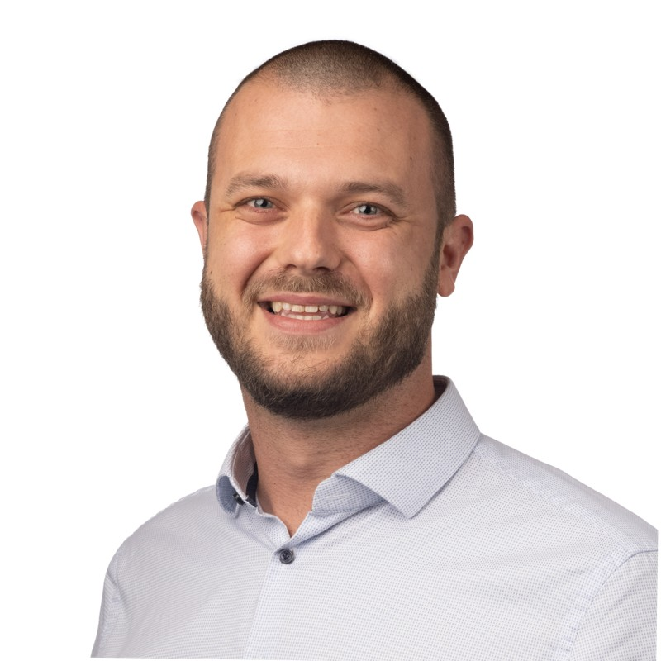


Stefan Dingemanse
Focus
Communities
Modern Workplace Consultant/Architect at Brainpulse IT
Azure Thursday
Dutch Virtual Desktop User Group
From
Hobbies
The Netherlands
Hyrox / Crossfit
My blog
Contact
https://stefandingemanse.cm
Stefan@brainpulse.it
Notes:
STEFAN

Slide 3


Patrick van den Born
Focus
Communities
End User Computing
DevOps way of working
GO-EUC
Dutch Virtual Desktop User Group
Microsoft and Citrix
From
Hobbies
The Netherlands
CrossFit
Weightlifiting
Sim racing
My blog
Contact
www.detechnischejongens.nl
www.go-euc.com
patrick@detechnischejongens.nl
Notes:
STEFAN

Slide 4
Agenda
Real World Scenarios
What are the risks
Easy to implement security tips
Recap
Questions
Notes:
STEFAN

Slide 5

Personal – Real world scenario
Notes:
PATRICK: Kanttekening dat dit mijn eigen ervaring is. Probeer het zoveel mogelijk te onderbouwen

Slide 6




Personal – Real world scenario
EUC Environments
Application configuration
Easy tips
Session Host defense
Notes:
Patrick: Kanttekening dat dit mijn eigen ervaring is. Probeer het zoveel mogelijk te onderbouwen Seen lot’s of EUC environments
Configured for application functionality
Easy tips to secure your session hosts
Focusing on securing the session hosts as last defense

Slide 7
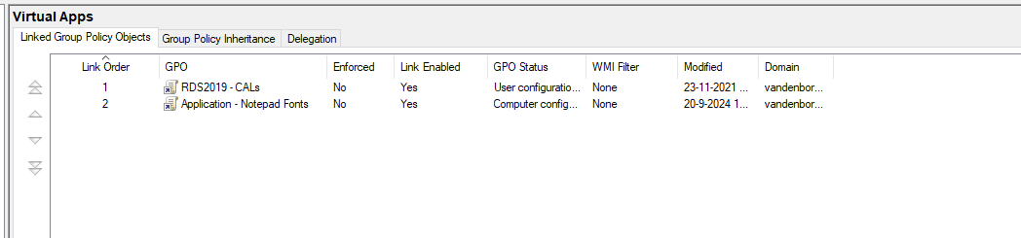
Customer example
Notes:
PATRICK: Kanttekening dat dit mijn eigen ervaring is. Probeer het zoveel mogelijk te onderbouwen

Slide 8
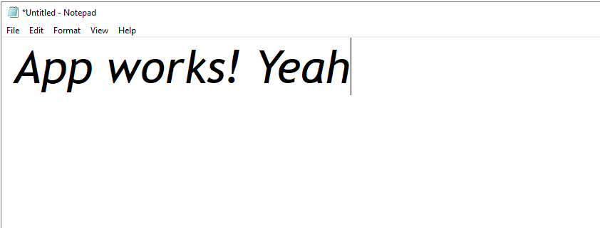
Customer example
Notes:
Patrick: Kanttekening dat dit mijn eigen ervaring is. Probeer het zoveel mogelijk te onderbouwen

Slide 9




Security findings from the field
Scripting
OS
Applications
Notes:
Patrick

Slide 10
Security findings from the field
Scripting
OS
Applications
Powershell v2 enabled
Powershell full language mode
Cached credentials
User write rights
Identical local admin passwords
Network communication
Outbound internet firewall
Windows updates strategy
No application whitelisting
Outdated applications
Internet Explorer 11
No virus scanners or EDR/XDR
Notes:
STEFAN / PATRICK

Slide 11
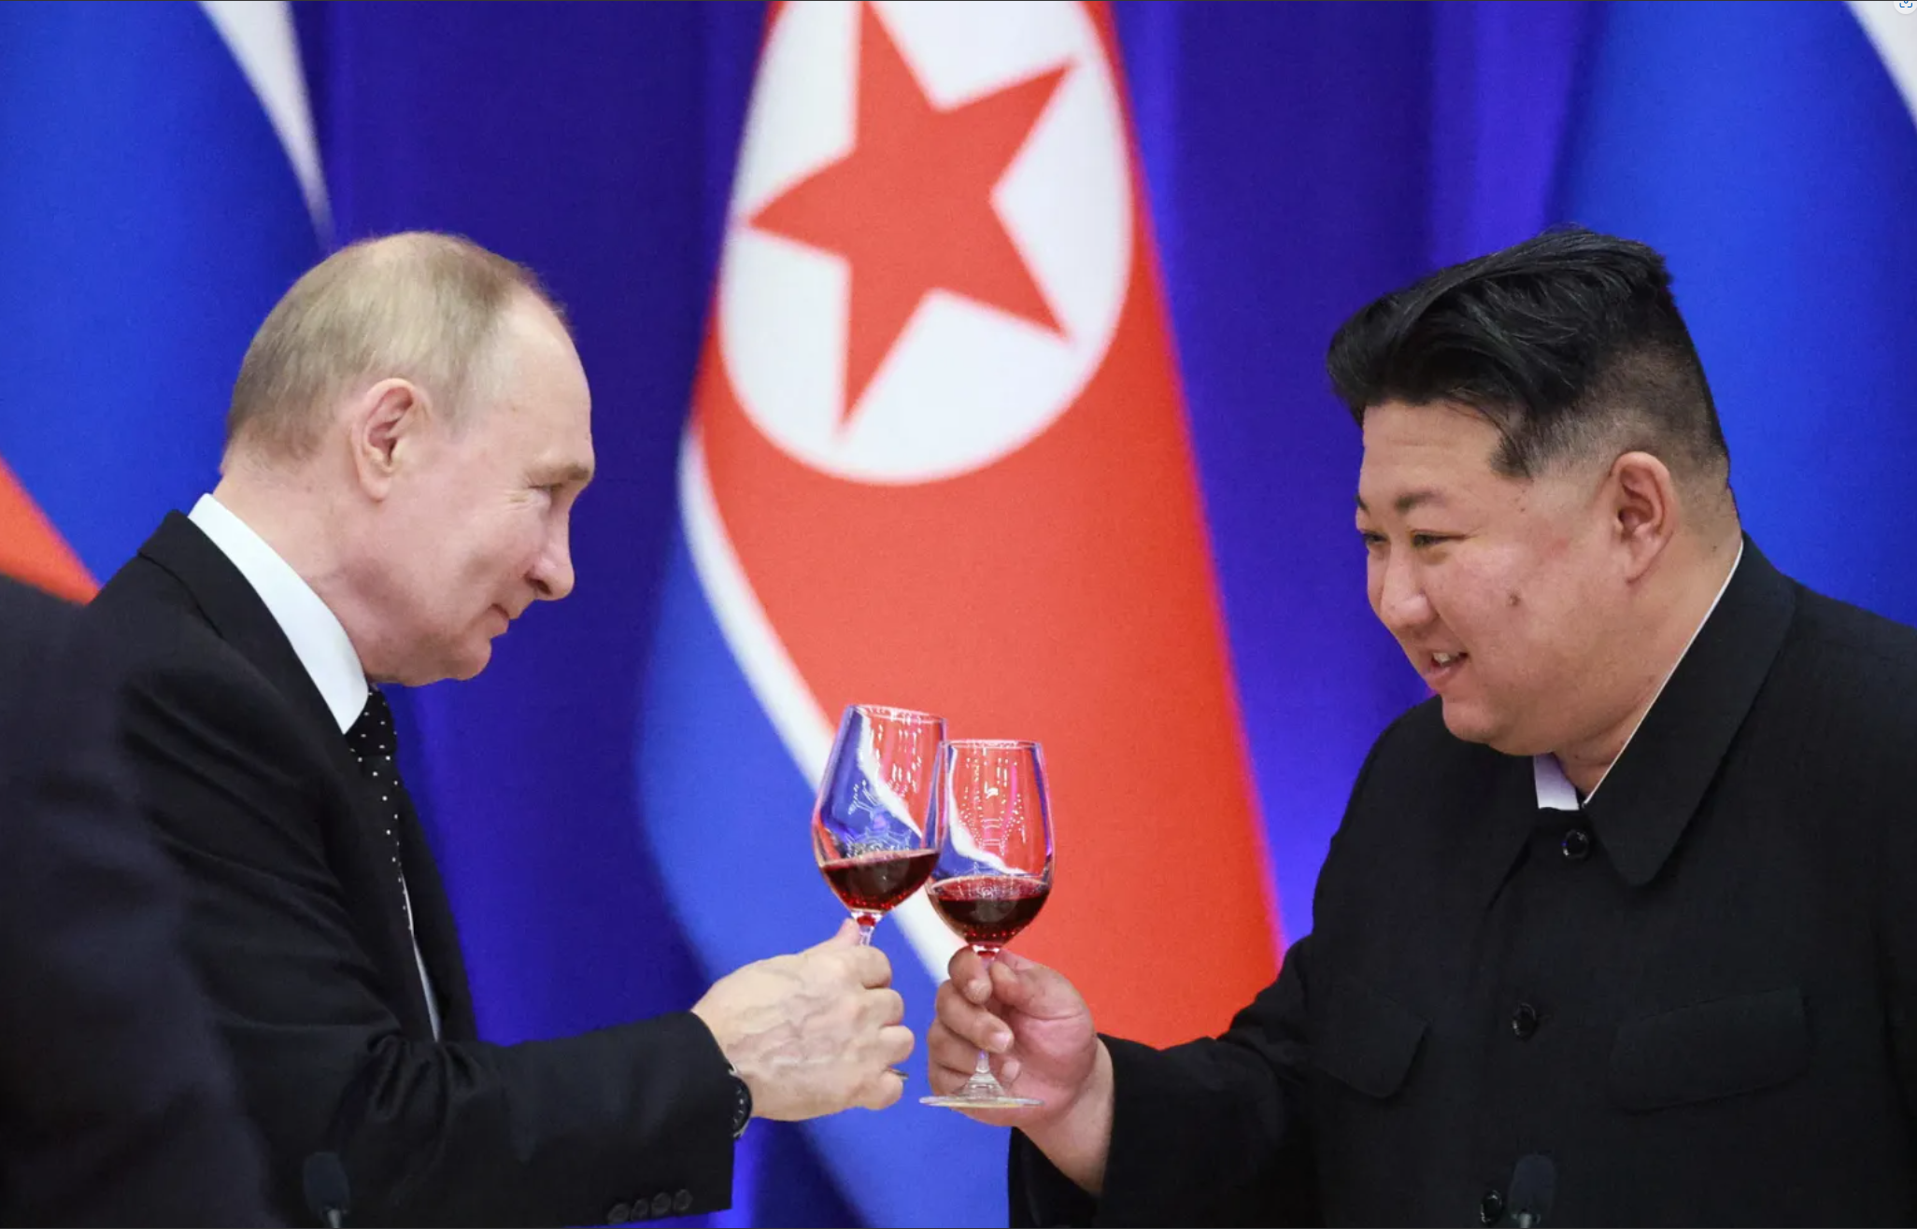
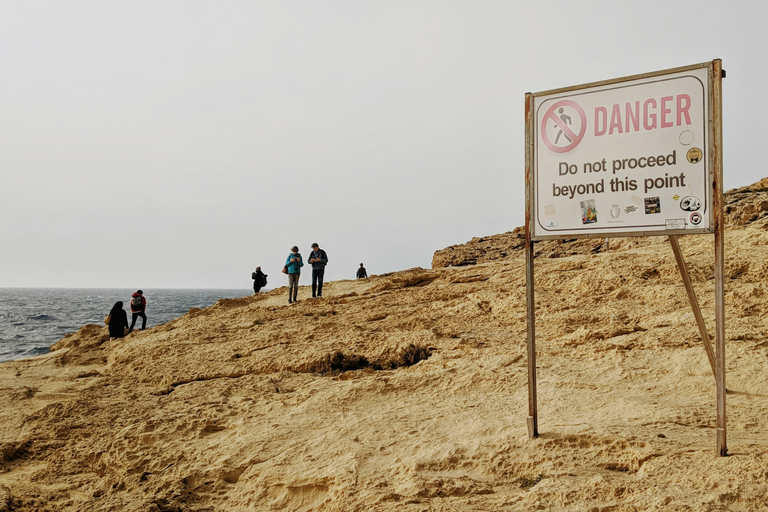

Slide 12




What are the risks?
Cyber war
Internet facing
Lateral movement
Ransomware Delivery Protocol
Notes:
RDP stands for Ransomware Deployment Protocol
Higher possibility of breach, due to Russian and North-Korea alliance
Remote Desktop and RemoteApp environments are internet facing
When connected to a RemoteApp easy lateral movement

Slide 13
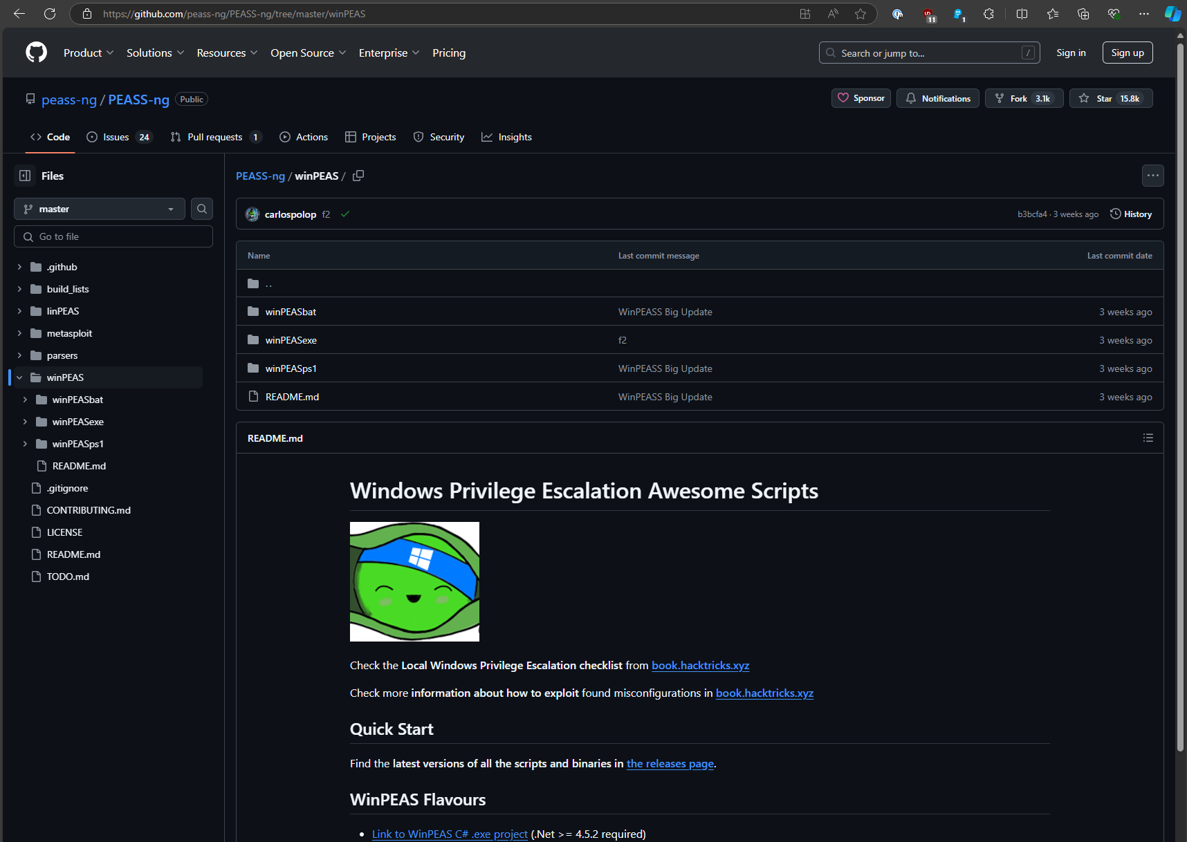
Windows Privilege Escalation Awesome Scripts

Slide 14
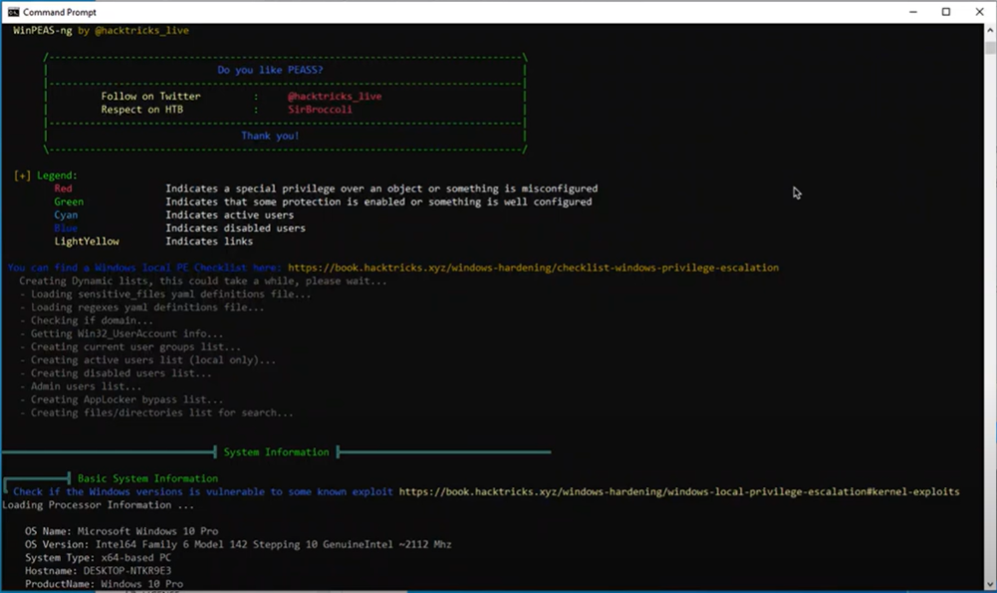
Windows Privilege Escalation Awesome Scripts

Slide 15
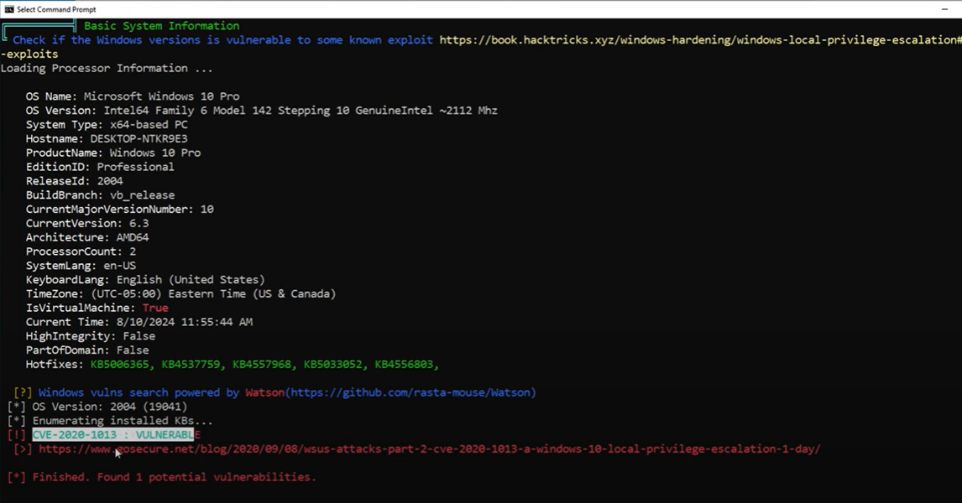
Windows Privilege Escalation Awesome Scripts
Notes:
Looks for a lot of different stuff use it for benchmarking

Slide 16

Image adjustments
Notes:
Stefan

Slide 17
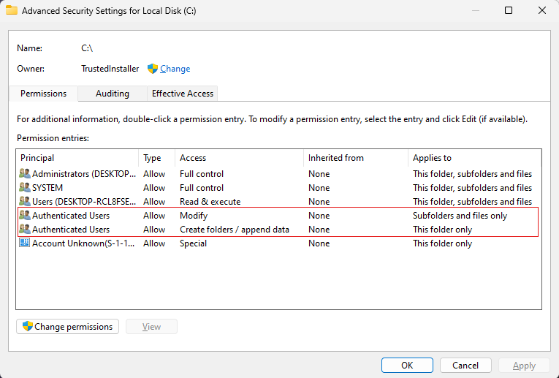
Image adjustments
Remove default rights for Authenticated Users
Notes:
Stefan

Slide 18
Image adjustments
# Adjust C-drive permissions Write-Host "##[C-Drive]Retrieving security principal for SID S-1-5-11 (NT AUTHORITY\Authenticated Users)" $SID = New-Object System.Security.Principal.SecurityIdentifier("S-1-5-11") $User = $SID.Translate([System.Security.Principal.NTAccount]) Write-Host "##[C-Drive]NT AUTHORITY\Authenticated Users group name is ($($User.Value))" Write-Host "##[command][C-Drive]Setting C-Drive permissions" $aclroot = Get-Acl -Path "C:\" $accessToRemove = @('AppendData', '-536805376') foreach ($access in $accessToRemove) { $removeAcl = $aclroot.Access | Where-Object { $_.IdentityReference -like $User.Value -and $_.FileSystemRights -like $access } if ($removeAcl) { $aclroot.RemoveAccessRule($removeAcl) Write-Host "##[C-Drive]Removed [$($User.Value)] with access [$access]" } } Write-Host "##[C-Drive]Start applying new ACL on C-Drive - This might take a while" $null = Set-Acl -Path "C:\" -AclObject $aclroot Write-Host "[C-Drive]Done!"
Notes:
Stefan

Slide 19
Image adjustments
#Disable Cached Logons on server Write-Host "##[command][Cached-Credentials] Disabling Cached Credentials" $securityCachedLogonsCount = [ordered] @{ RegistryPath = "HKLM:\SOFTWARE\Microsoft\Windows NT\CurrentVersion\Winlogon" RegistryName = "CachedLogonsCount" RegistryValue = "0" RegistryType = "String" } $securityCachedLogonsCount | Format-Table -AutoSize | Write-output Set-RegistryValue @securityCachedLogonsCount Write-Host "[Cached-Credentials] done"
Notes:
Stefan

Slide 20
Image adjustments
$featureVariables = [ordered]@{ Online = $true FeatureName = "MicrosoftWindowsPowershellV2Root" } #Logging Write-Host "Disable: $($featureVariables.FeatureName)" $featureVariables | Format-Table -AutoSize | Write-output #Disable Windows Feature Disable-WindowsOptionalFeature @featureVariables
Notes:
Stefan

Slide 21
Image adjustments
$featureVariables = [ordered]@{ Online = $true FeatureName = "Internet-Explorer-Optional-amd64" } #Logging Write-Host "Disable: $($featureVariables.FeatureName)" $featureVariables | Format-Table -AutoSize | Write-output #Disable Windows Feature Disable-WindowsOptionalFeature @featureVariables
Notes:
Stefan

Slide 22
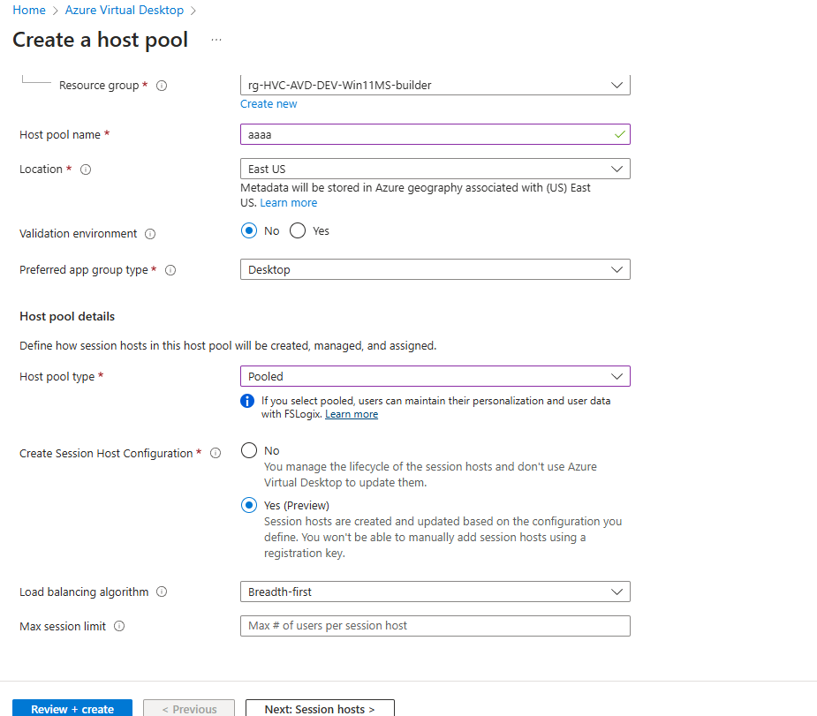
Consistent Image Release Strategy
Citrix Machine Creation Services Citrix Provisioning Services Azure Virtual Desktop Session Host Configuration Omnissa Linked Clones
Notes:
Patrick

Slide 23

Creating Confidence in the Connected World™
At CIS®, we’re harnessing the power of the global IT community to safeguard public and private organizations against cyber threats. Join us.
World-Renowned Best Practices and Expert Communities
Notes:
Patrick / Stefan

Slide 24





The CIS Benchmarks™ are prescriptive configuration recommendations. They represent the consensus-based effort of cybersecurity experts globally to help you protect your systems against threats more confidently.
A security baseline is a group of Microsoft-recommended configuration settings that explains their security implication. These settings are based on feedback from Microsoft security engineering teams, product groups, partners, and customers.
STIGs are developed by the Defense Information Systems Agency (DISA) for the Department of Defense (DoD). They offer a set of guidelines for various operating systems, including Windows and Linux, to secure an organization’s assets against cybersecurity threats.
Lower the attach surface
Notes:
Stefan: STIG toevoegen
STIG stands for Security Technical Implementation Guides
STIGs often provide a more military-focused baseline, given their DoD origins. CIS Benchmarks offer broader functionality that can be applied across different industries.

Slide 25
The CIS Benchmarks™ are prescriptive configuration recommendations. They represent the consensus-based effort of cybersecurity experts globally to help you protect your systems against threats more confidently.
A security baseline is a group of Microsoft-recommended configuration settings that explains their security implication. These settings are based on feedback from Microsoft security engineering teams, product groups, partners, and customers.
STIGs are developed by the Defense Information Systems Agency (DISA) for the Department of Defense (DoD). They offer a set of guidelines for various operating systems, including Windows and Linux, to secure an organization’s assets against cybersecurity threats.
CIS benchmarks provide two levels of security settings:
Level 1 recommends essential basic security requirements that can be configured on any system and should cause little or no interruption of service or reduced functionality.
Level 2 recommends security settings for environments requiring greater security that could result in some reduced functionality.
Notes:
Stefan: STIG toevoegen
STIG stands for Security Technical Implementation Guides
STIGs often provide a more military-focused baseline, given their DoD origins. CIS Benchmarks offer broader functionality that can be applied across different industries.

Slide 26
The CIS Benchmarks™ are prescriptive configuration recommendations. They represent the consensus-based effort of cybersecurity experts globally to help you protect your systems against threats more confidently.
A security baseline is a group of Microsoft-recommended configuration settings that explains their security implication. These settings are based on feedback from Microsoft security engineering teams, product groups, partners, and customers.
STIGs are developed by the Defense Information Systems Agency (DISA) for the Department of Defense (DoD). They offer a set of guidelines for various operating systems, including Windows and Linux, to secure an organization’s assets against cybersecurity threats.
1 | AVD_PROD_COMP_Settings | All Computer related policy settings combined
2 | AVD_PROD_USER_Settings | All User related policy settings combined
3 | AVD_PROD_AppLocker | AppLocker Policy
4 | AVD_PROD_CIS_Exceptions | User/Computer Exceptions on General Cis | Enforced
5 | AVD_PROD_CIS | CIS Policy Microsoft Windows, Office, Edge, RemoteApps (unchanged)
Notes:
Stefan: STIG toevoegen
STIG stands for Security Technical Implementation Guides
STIGs often provide a more military-focused baseline, given their DoD origins. CIS Benchmarks offer broader functionality that can be applied across different industries.

Slide 27
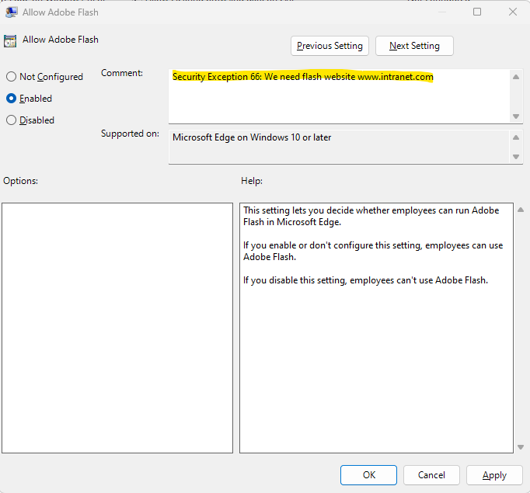
Notes:
Patrick - > Voorbeeld exception report

Slide 28




Microsoft Security Baselines and CIS Remote Desktop Protocol
Notes:
STEFAN
Edge
Browser
Defender

Slide 29

The CIS Benchmarks™ are prescriptive configuration recommendations. They represent the consensus-based effort of cybersecurity experts globally to help you protect your systems against threats more confidently.
A security baseline is a group of Microsoft-recommended configuration settings that explains their security implication. These settings are based on feedback from Microsoft security engineering teams, product groups, partners, and customers.
STIGs are developed by the Defense Information Systems Agency (DISA) for the Department of Defense (DoD). They offer a set of guidelines for various operating systems, including Windows and Linux, to secure an organization’s assets against cybersecurity threats.
Validate and test
Notes:
Stefan: STIG toevoegen
STIG stands for Security Technical Implementation Guides
STIGs often provide a more military-focused baseline, given their DoD origins. CIS Benchmarks offer broader functionality that can be applied across different industries.

Slide 30
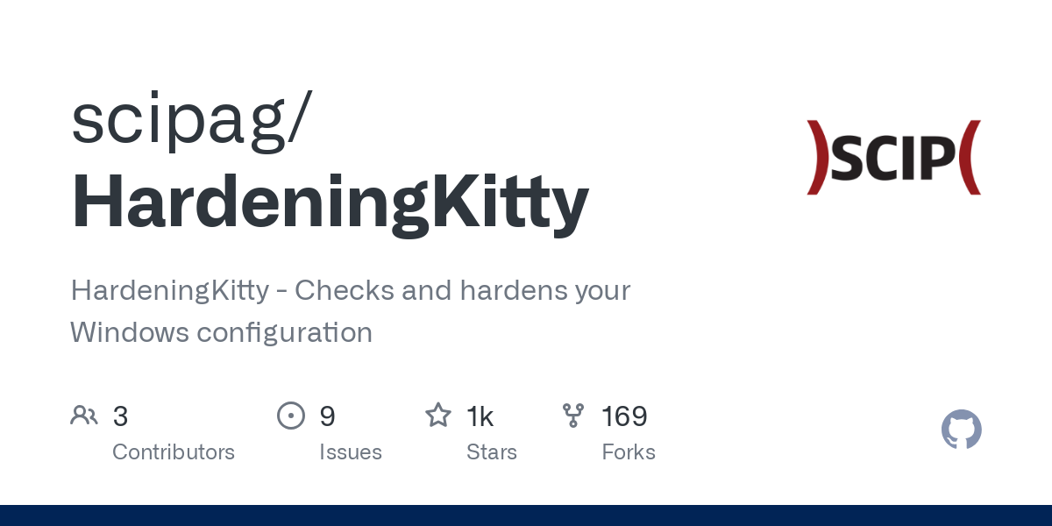




https://github.com/scipag/HardeningKitty
Good Old PolicyAnalyzer
Vulnerability Scanner
Notes:
Stefan: STIG toevoegen
STIG stands for Security Technical Implementation Guides
STIGs often provide a more military-focused baseline, given their DoD origins. CIS Benchmarks offer broader functionality that can be applied across different industries.

Slide 31
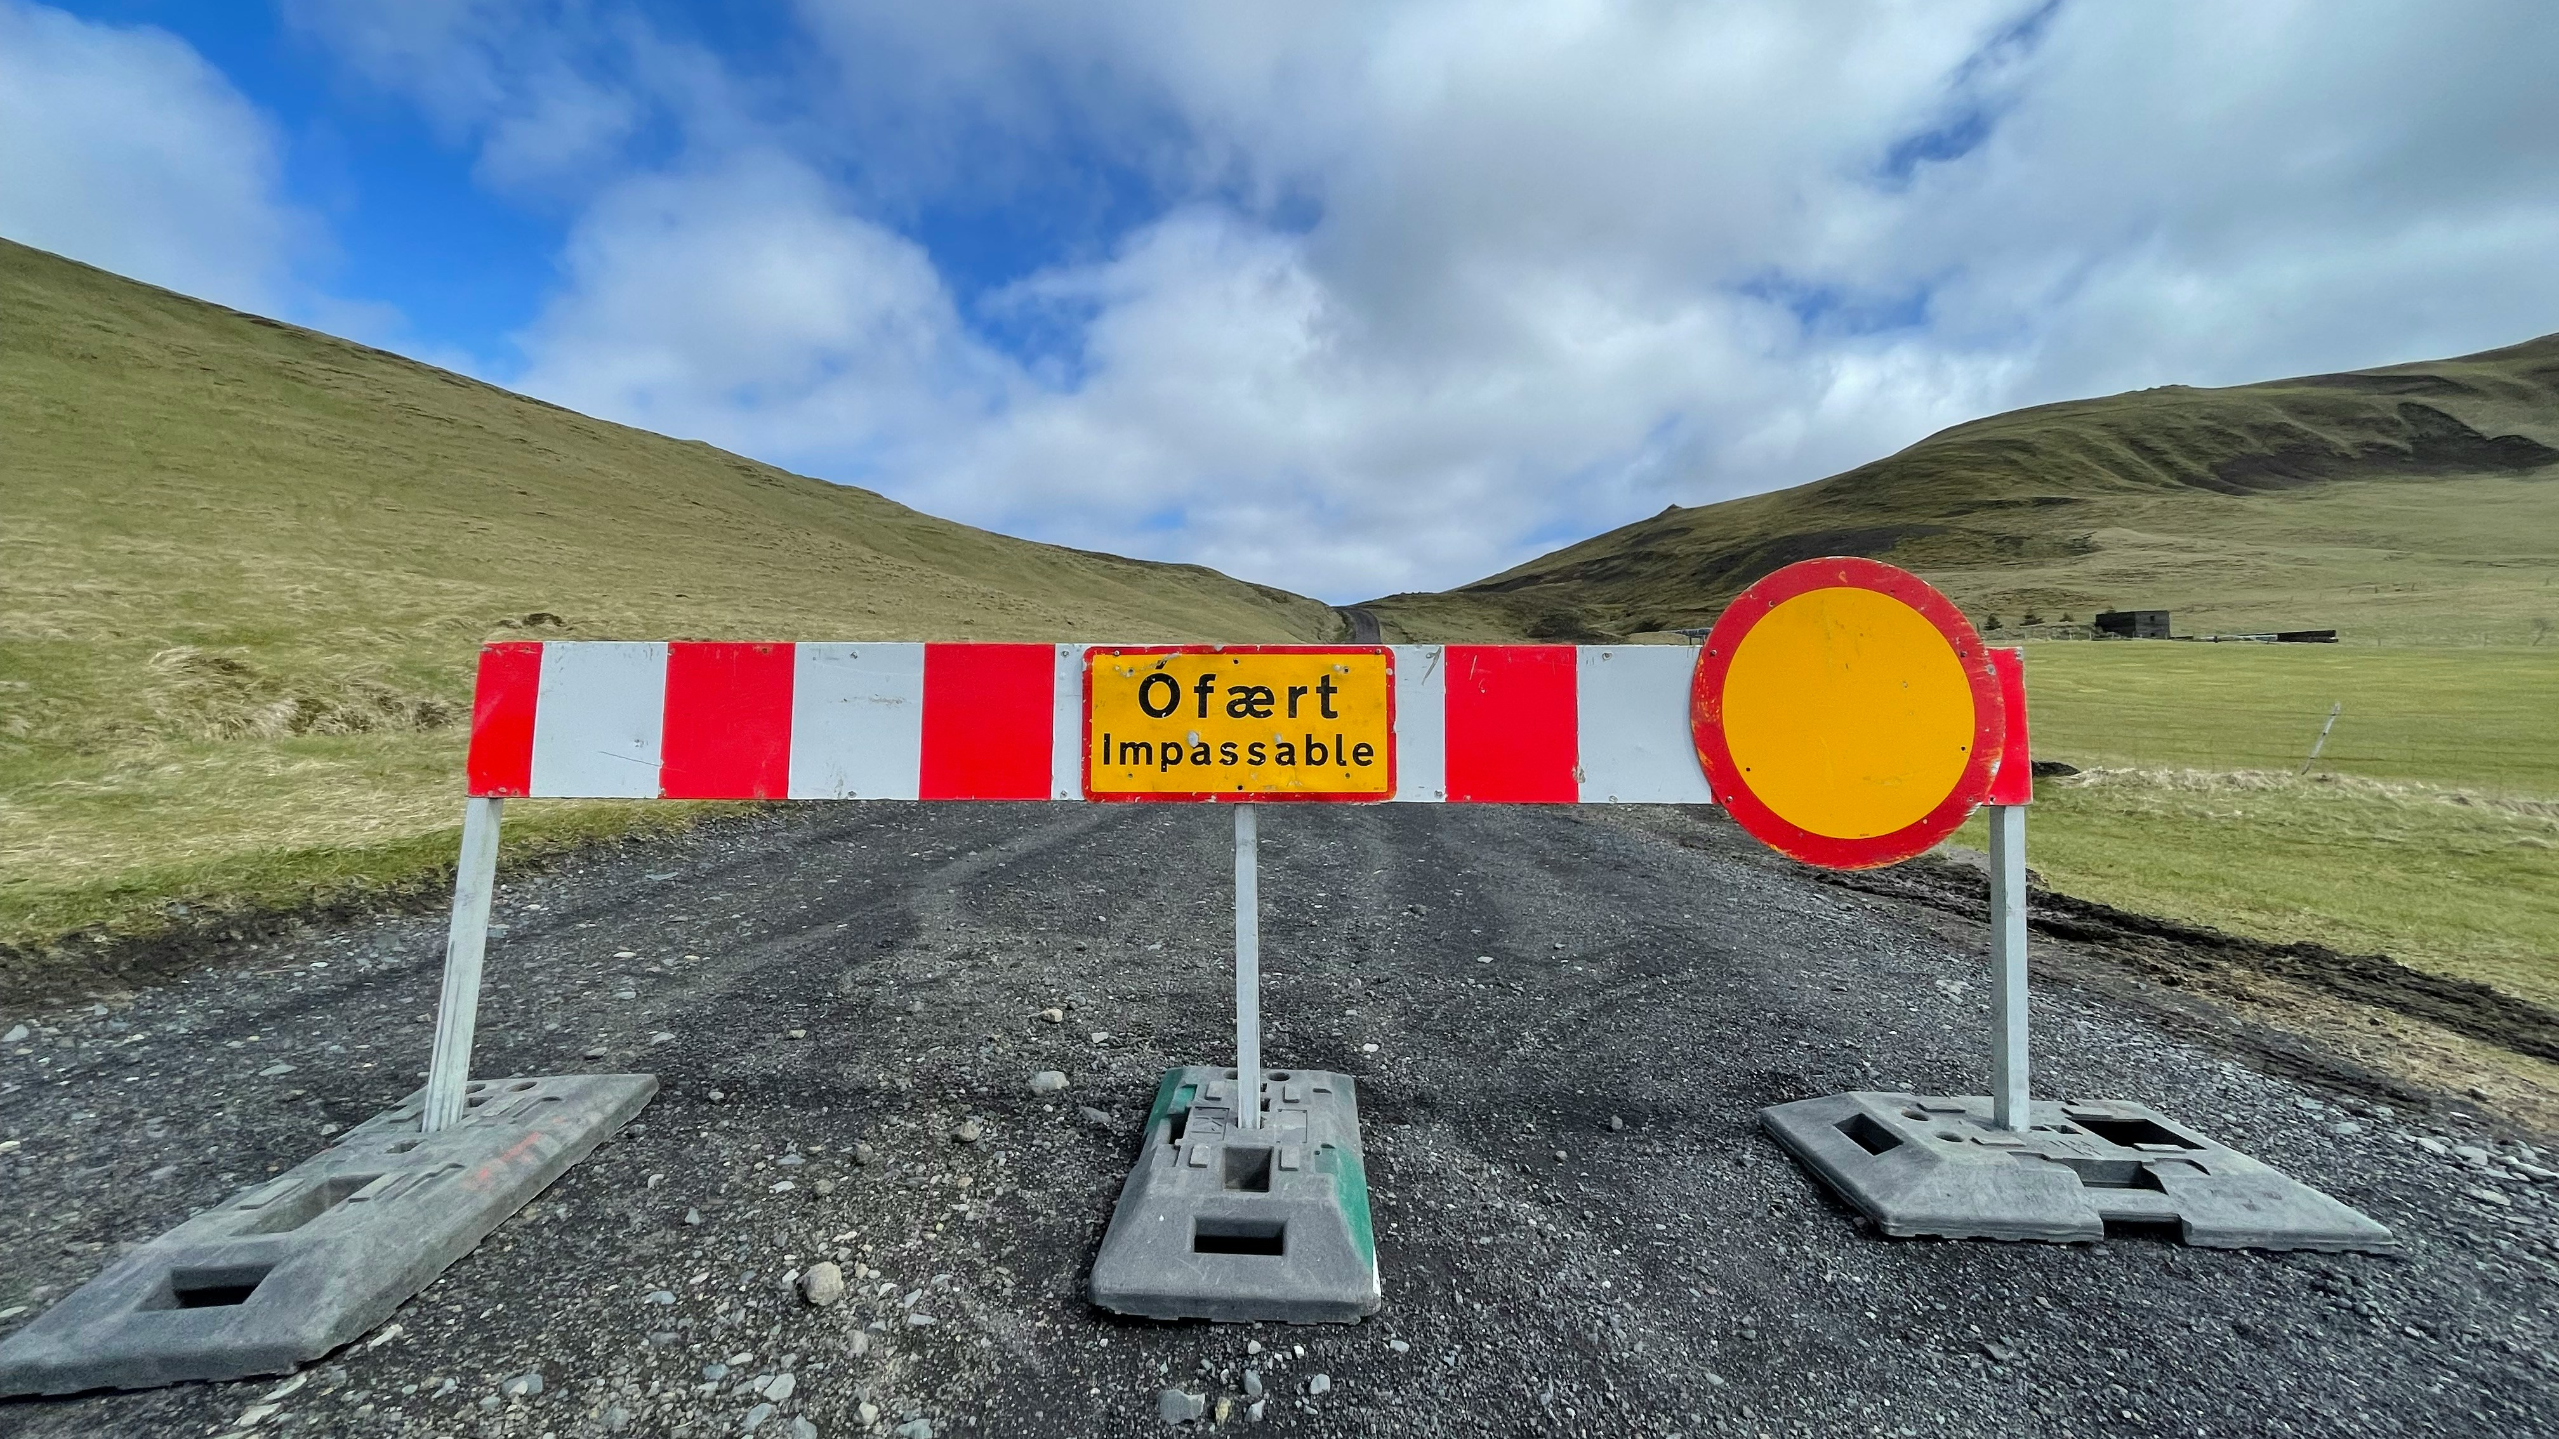
Application whitelisting the easy way
Notes:
Patrick

Slide 32
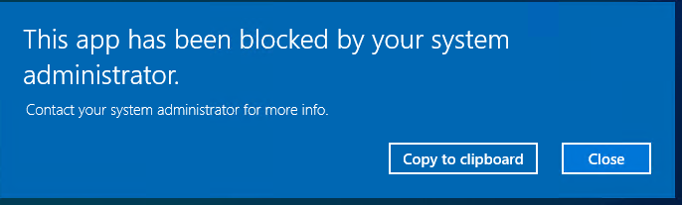




Application whitelisting the easy way
Allow applications
Pen testers
Abnormally detection
User writable folders
Notes:
It will only allow specific applications to run
Penetration testers loved the way we’ve implemented this
Add abnormaly detection to SOC
Pentesters/hackers will try to execute lots of scripts which will be blocked
Default AppLocker rules are not secure due to user writable folders
Simple configuration thanks to AaronLocker
Applocker for GPO’s
WDAC for Intune
Protects user writable folders
URL: https://github.com/microsoft/AaronLocker

Slide 33
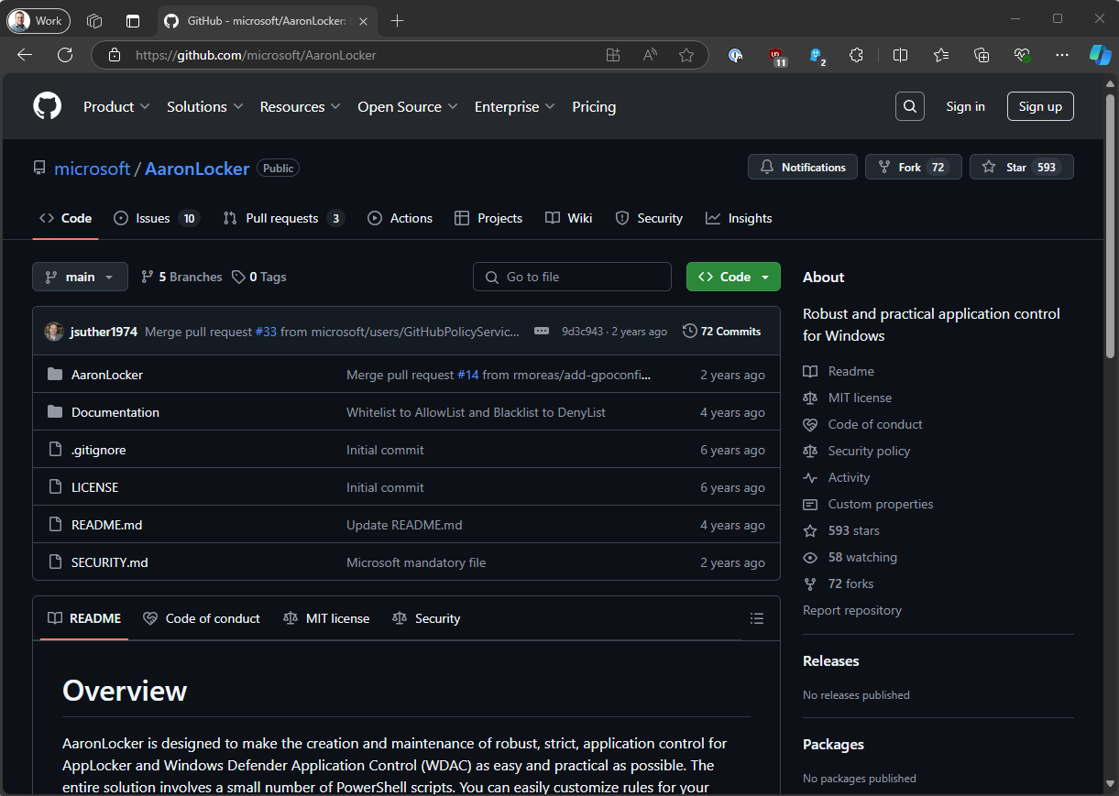
Application whitelisting the easy way

Slide 34
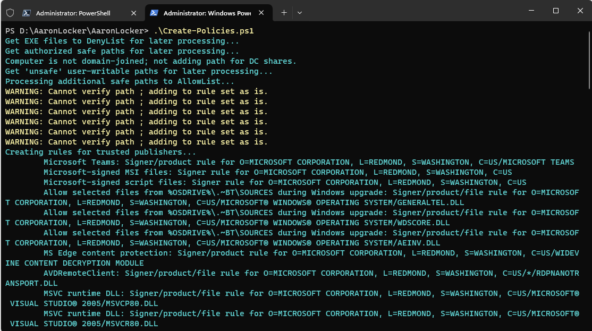
Application whitelisting the easy way

Slide 35
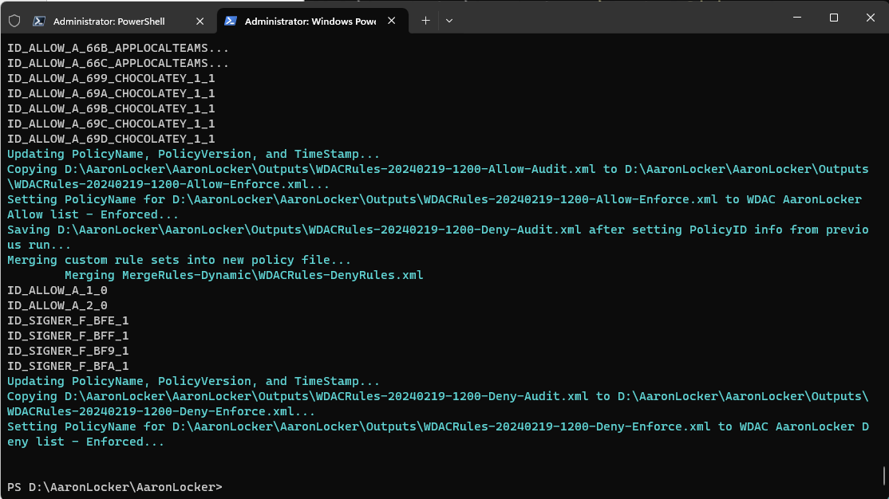
Application whitelisting the easy way

Slide 36
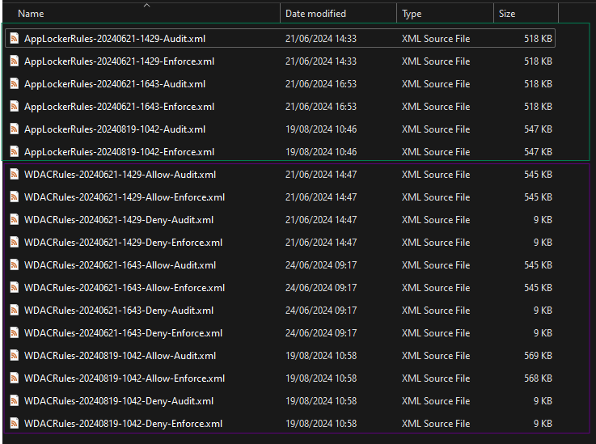
Application whitelisting the easy way

Slide 37
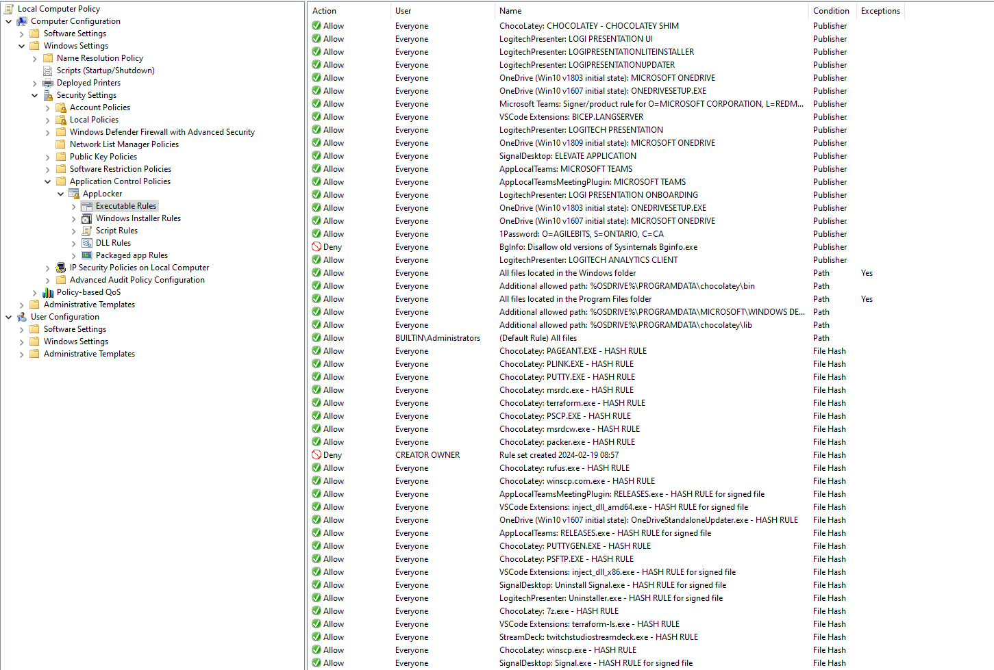
Application whitelisting the easy way
Notes:
Verwijzing naar Niels Kok zijn presentative WDAC notes from the Field

Slide 38
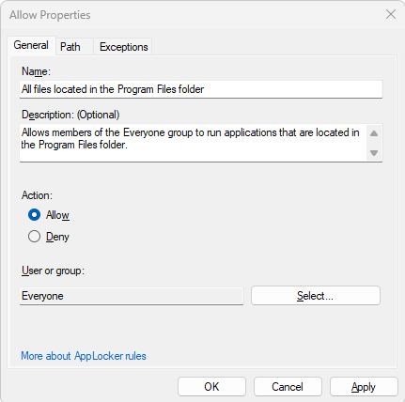
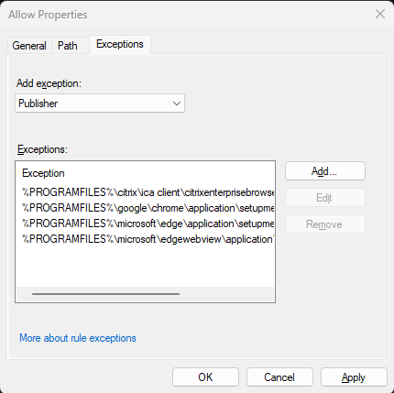
Application whitelisting the easy way

Slide 39
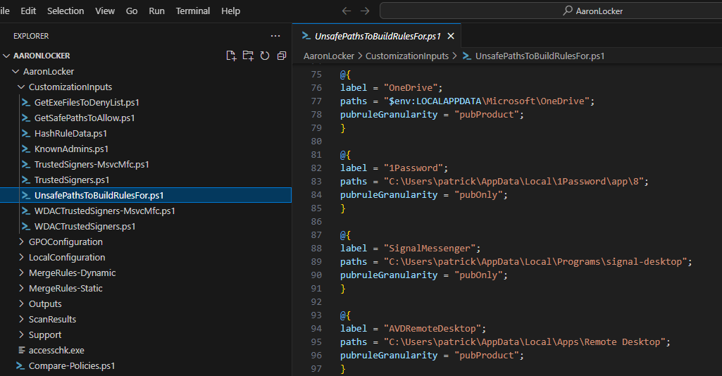
Application whitelisting the easy way

Slide 40
Application whitelisting the easy way
Tips:
Add your computer to domain if applicable
AaronLocker will scan UNC paths
Add exception rules to the “CustomizationInputs” scripts
Don’t add AppLocker rules manually
Do not exclude a complete user writeable folder, or your doomed!
Rerun AaronLocker on updates (filehashes will change!)

Slide 41

Local Admin Password Protection
Notes:
STEFAN: LAPS aanpassen

Slide 42
Local Admin Password Protection
Prevent identical local admin passwords on every session host
Prevent pass the hash attacks
Procedures for non-persistent images
CTX331247: Randomizing Local Admin Passwords in Non-persistent Environments

Slide 43

Block east-west network traffic
Notes:
Stefan

Slide 44
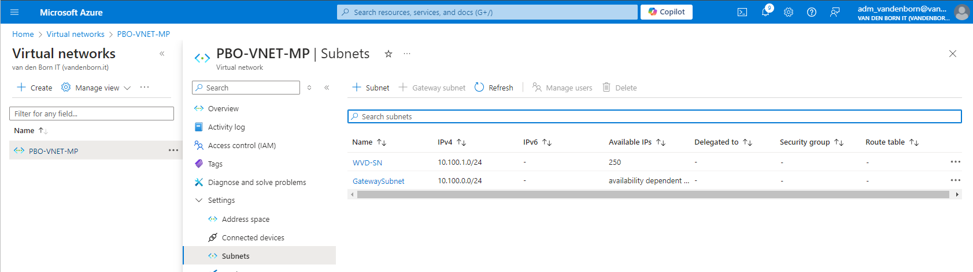
Block east-west network traffic

Slide 45
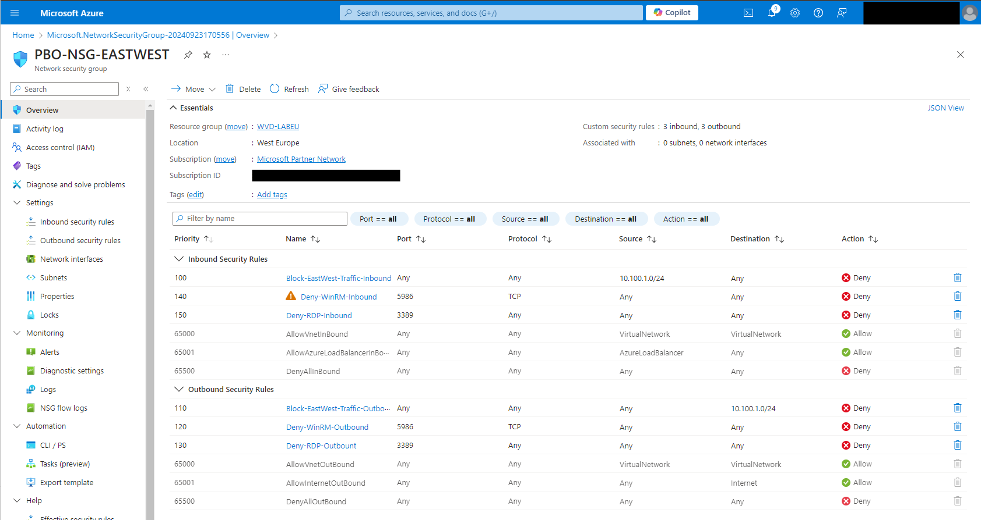
Block east-west network traffic

Slide 46
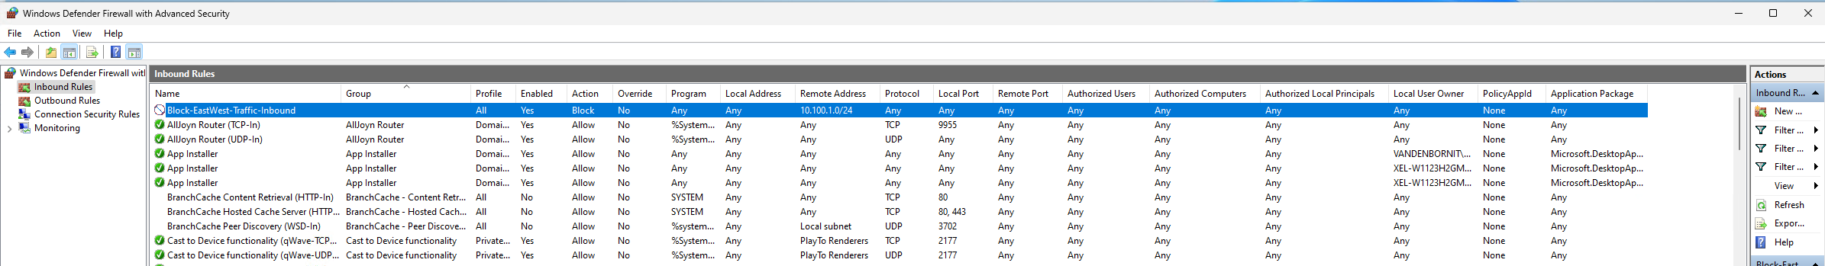
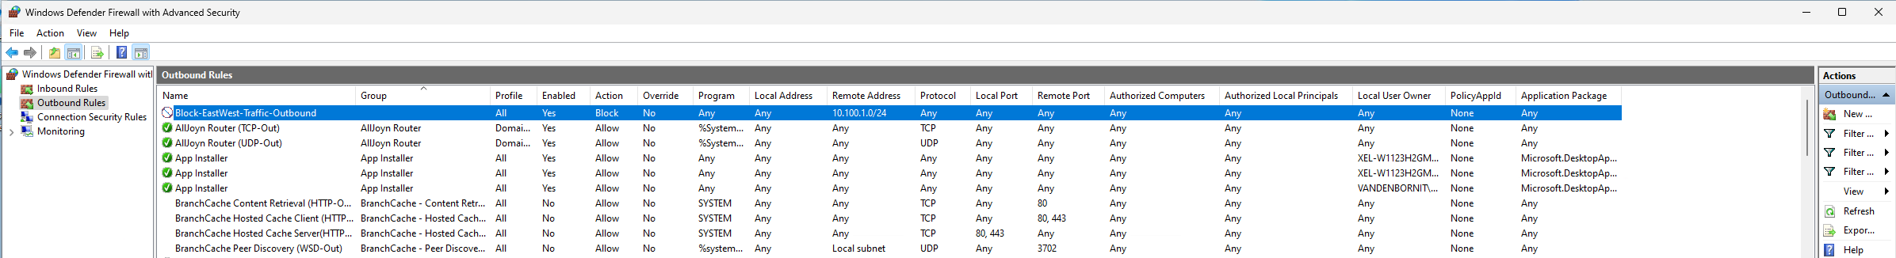
Block east-west network traffic

Slide 47

Block north-south network traffic

Slide 48


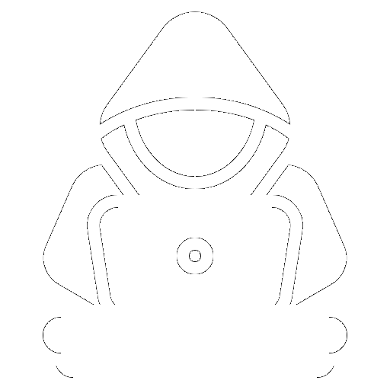
Block north-south traffic
SMB – port 445

Slide 49
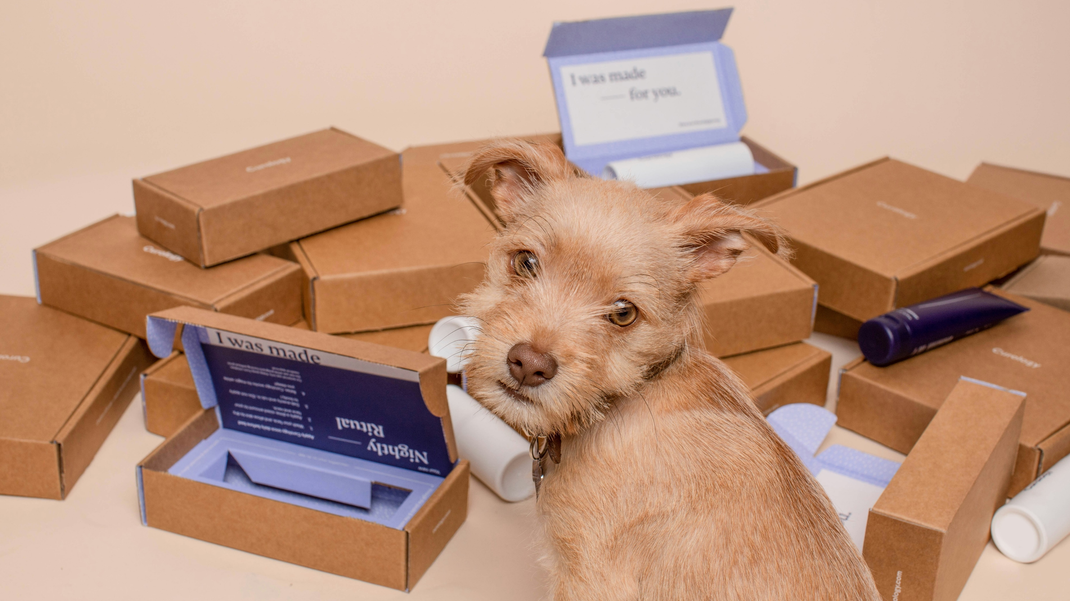
Package manager

Slide 50
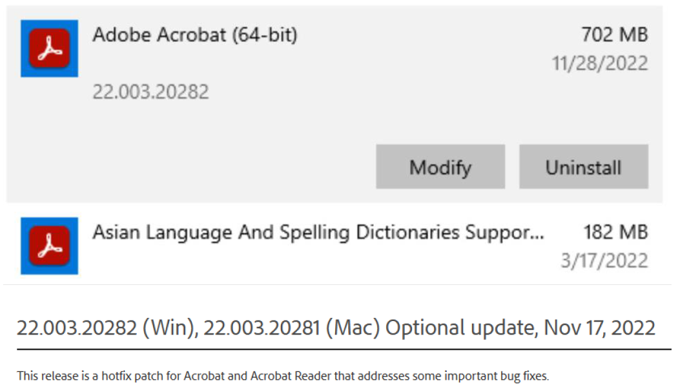
Package manager

Slide 51



Package manager
WinGet
NeverRed
Evergreen
Notes:
Common package managers
WinGET
Chocolatey
Update packages automatically
Or download the most recent application
Evergreen
Screenshot report

Slide 52
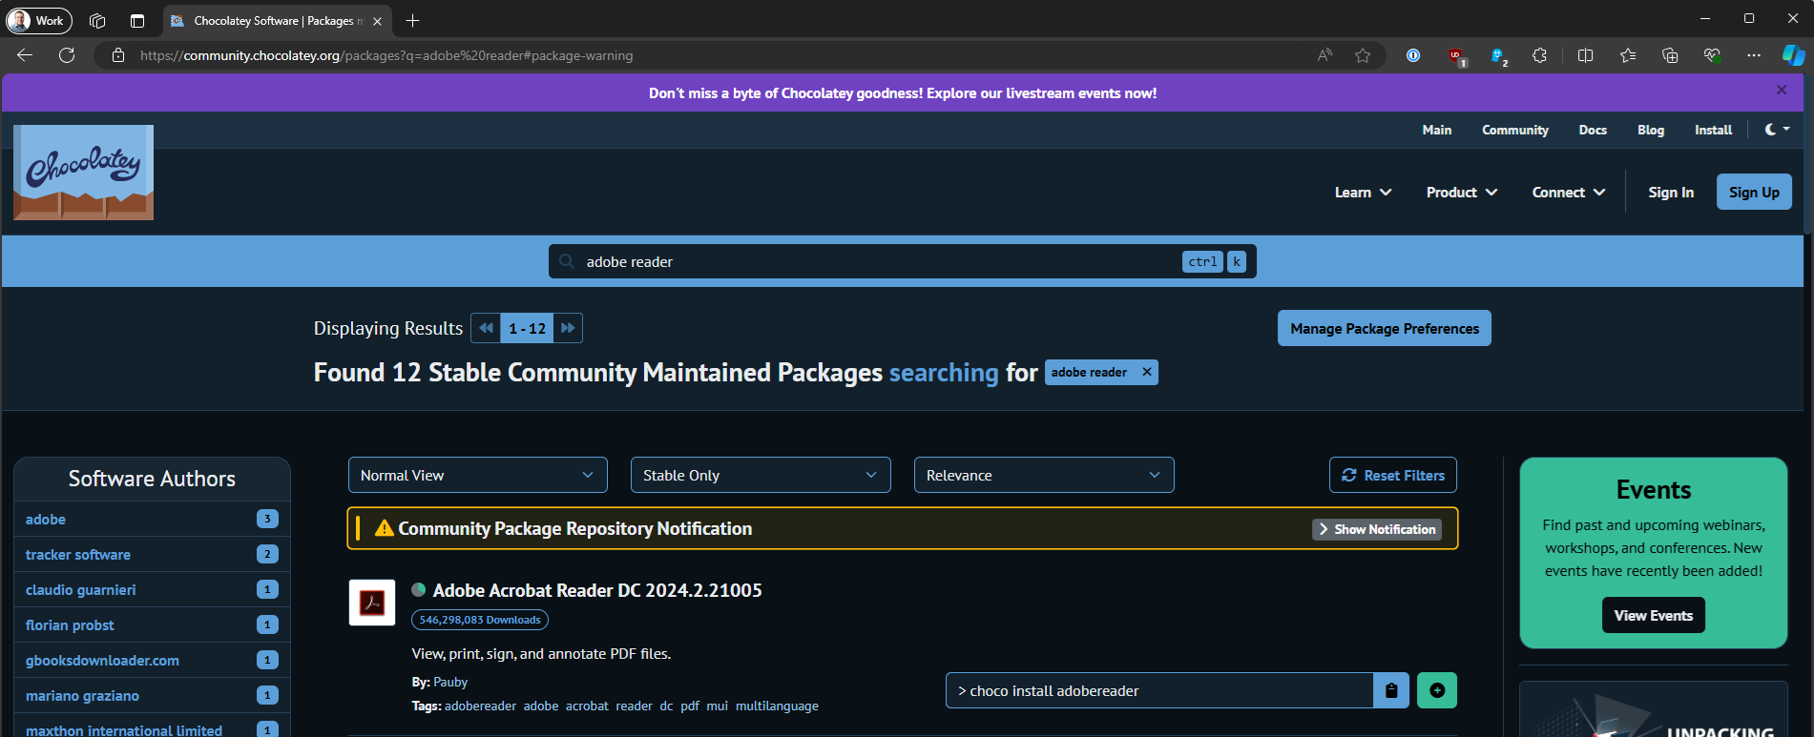
Package manager

Slide 53
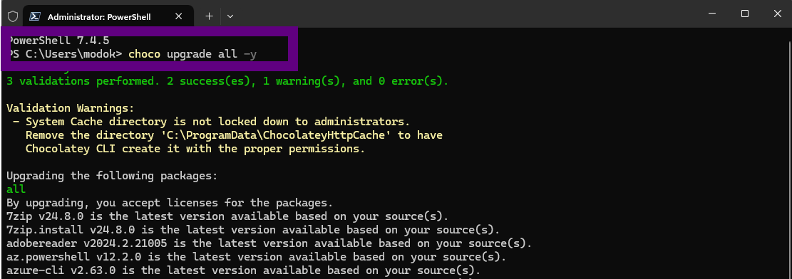
Package manager

Slide 54
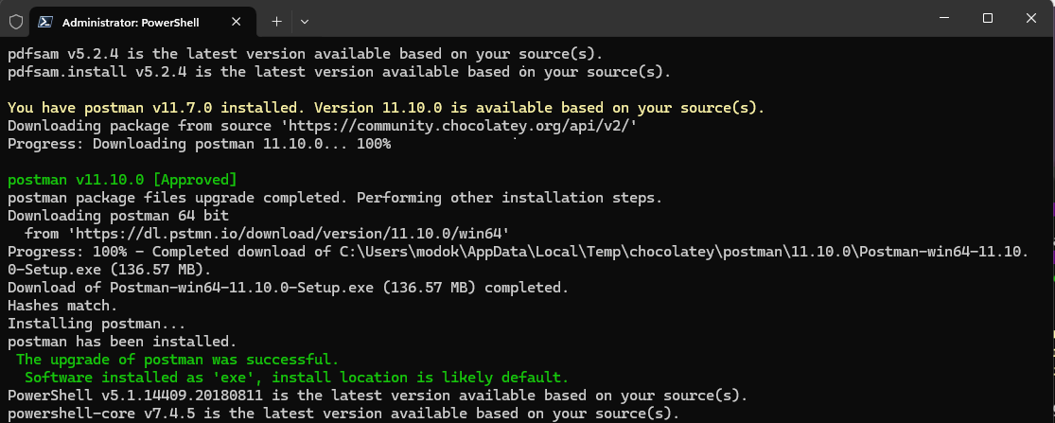
Package manager

Slide 55

Pentest your environment

Slide 56




Pentest your environment
Pentest your environment
Blue team
Regular
Fix findings
Red team
Notes:
Blue team testing
Regular base
Fix findings

Slide 57
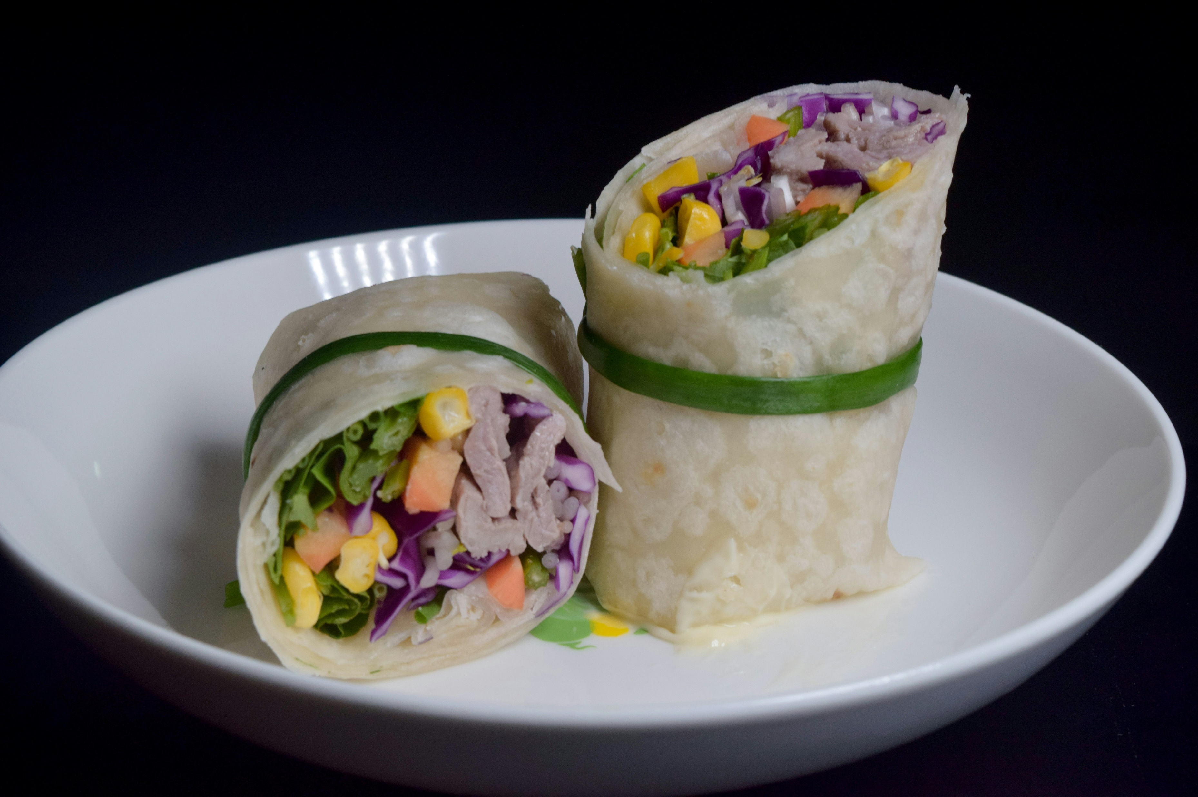
Wrap up

Slide 58







Wrap up
Cyber war
Last line of defense
Harden golden image
CIS Policies
AaronLocker
East-West traffic North-South traffic
Package manager
Penetration test

